Slide 1
Contribution of New Radiation Response Models to International Radiation Protection Guidelines
Oleg Belyakov*, Eduardo Zubizarreta**, and May Abdel Wahab***
*Radiation Biologist, speaker
**Head of the Section of Applied Radiation Biology and Radiotherapy
***Director of the Division of Human Health
Department of Nuclear Sciences and Applications
International Atomic Energy Agency, Vienna
Disclaimer: this presentation has neither been approved nor endorsed by the IAEA

Slide 2
Introduction
Radiation protection guidelines are covered internationally by three main bodies.
The United Nations Scientific Committee on the Effects of Atomic Radiation (UNSCEAR) evaluates and summarizes scientific evidence related to sources and effects of ionizing radiation.
The International Commission on Radiological Protection (ICRP) translates this knowledge into radiation protection.
The International Atomic Energy Agency prepares the IAEA Safety Standards.
These standards are recommended for implementation in national radiation safety systems.

Slide 3
International system of radiotin protection
ICRP “issues recommenda-tions on all aspects of radiological protection”
UNSCEAR evaluates scientific evidence on effects of ionizing radiation
Establishment and maintenance of national legal, regulatory and organizational framework; adoption of regulations and guides
IAEA Safety Standards provides Safety Fundamentals, Requirements and Guides

Slide 4
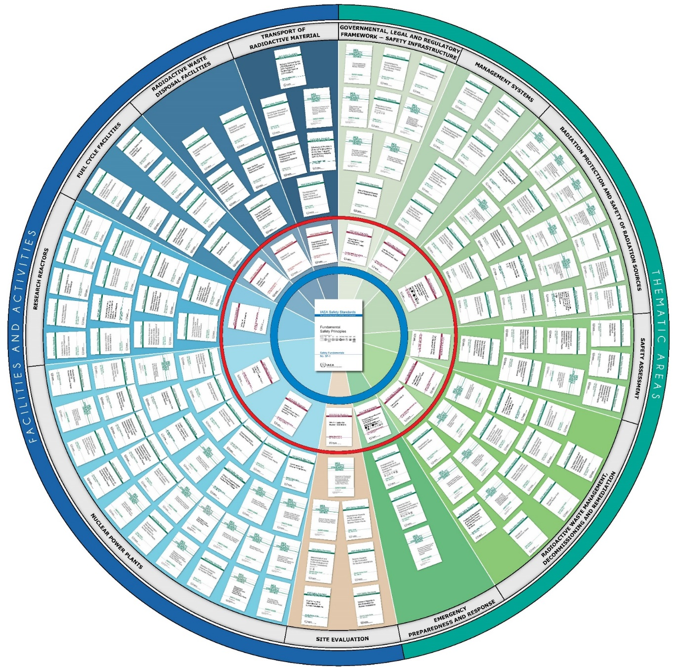
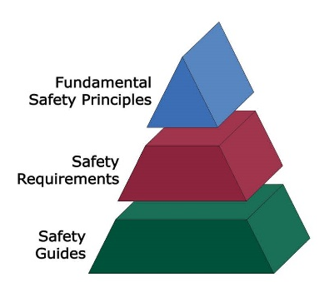
IAEA Safety Standards (as of September 2016) protecting people and the environment
The hierarchy of the Safety Standards begins with the Fundamental Safety Principles, then the Safety Requirements and finally the Safety Guides.
The Safety Standards are produced with the involvement
and agreement of all IAEA Member States and provide a global reference for nuclear safety.

Slide 5
UNSCEAR 2006 report: Effects of ionizing radiation
Volume II, Annex C “Non-targeted and delayed effects of exposure to ionizing radiation” (published in 2009).
Comprehensive review of radiation induced bystander, abscopal effects, genomic instability and clastogenic factors.
“…direct epidemiological observations and associated quantification of the health effects of radiation incorporate all mechanistic elements, including the targeted (direct) effects of irradiation as well as the non-targeted and delayed effects…”
“…the data currently available do not require changes in radiation risk coefficients for cancer and hereditary effects of radiation in humans.”
More research are needed to “…provide mechanistic insights into how radiation induces its observed health effects.”

Slide 6
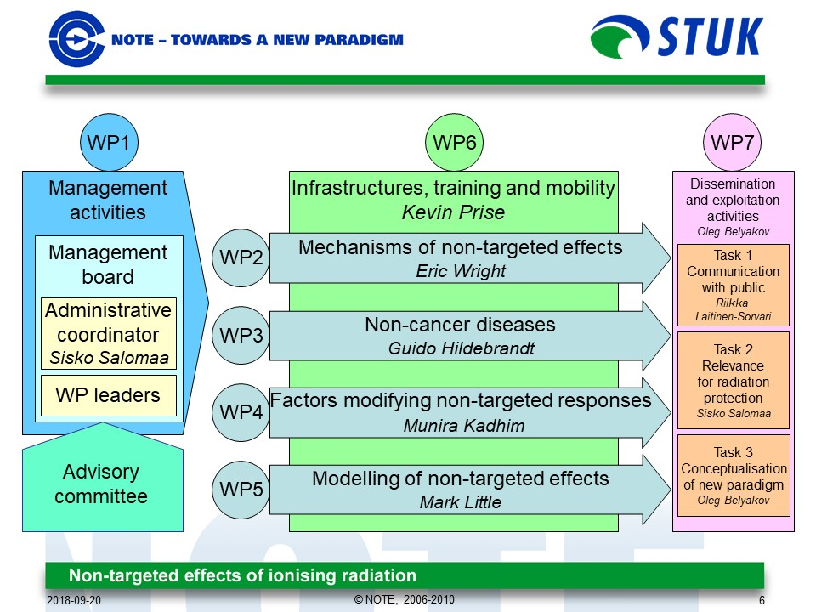
Non-targeted effects of ionising radiation (NOTE) EURATOM Integrated Project 2006-2010
19 partner organisations.
7 workpackages.
12M€ of budget.
The main aim was to investigate mechanisms of non-targeted effects (bystander effects, genomic instability and adaptive response).
How they could contribute to radiation protection standards.

Slide 7
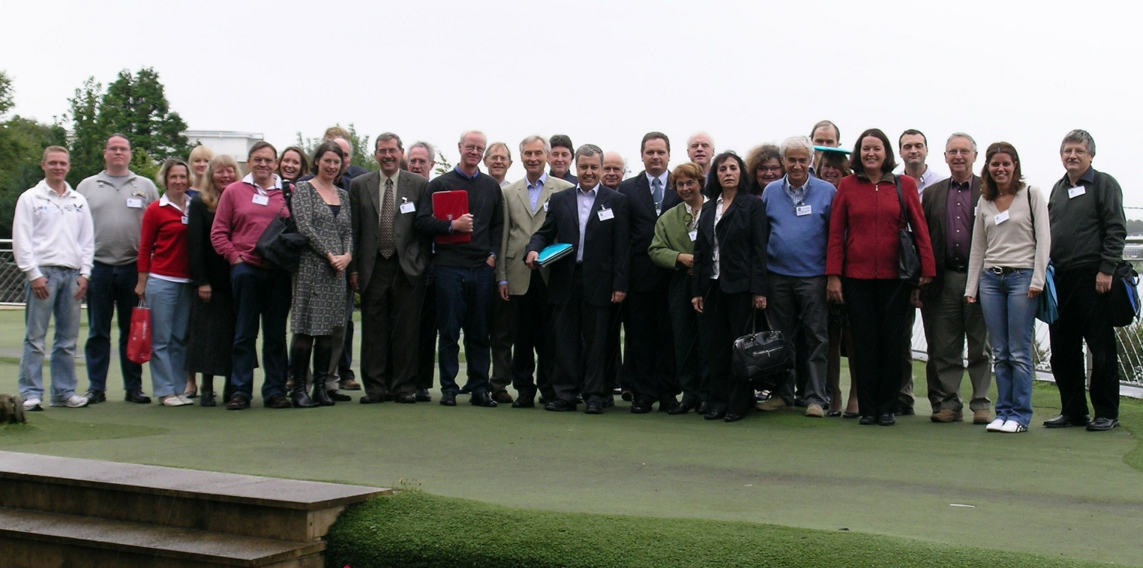
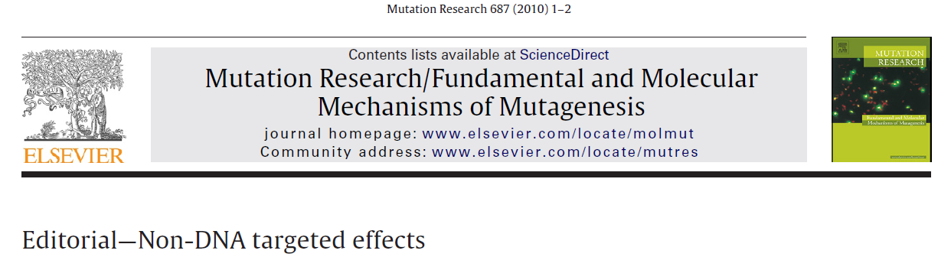
NOTE workshop “Conceptualisation of new paradigm” 13-14 September 2008, Galway, Ireland
The main conclusion was that a new radiobiological paradigm cannot be formulated at the moment due to lack of consensus and value of non-targeted effects for radiation protection is still uncertain.
A special issue of Mutation Research (687,1-2) with 15 papers and editorial was published in 2010.

Slide 8
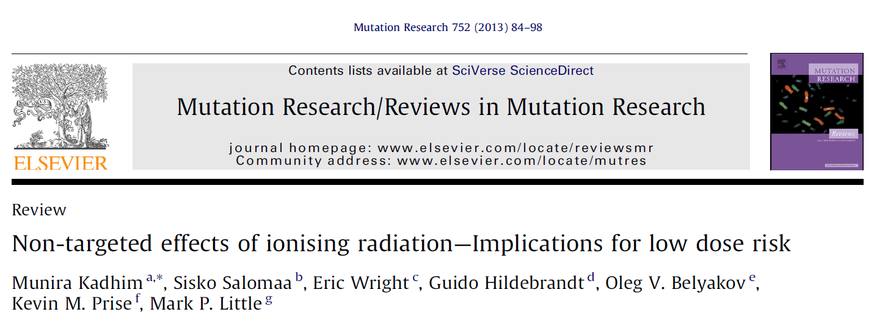
“Position paper” of NOTE IP (2013)
It was concluded that the precise mechanisms of non-targeted effects are not known and there is no universally accepted biological model. Therefore these evidences has a limited impact on radiation protection. Another conclusion was that more mechanistic studies are needed.

Slide 9
RASSC Topical Session: Individual Susceptibility to Radiation, 24 June 2015, IAEA HQs, Vienna
The Radiation Safety Standards Committee became interested in the potential of individual susceptibility to radiation protection and arranged a special session.
Drs Michel Bourguignon, Nicolas Foray, Bill Morgan and Gustavo Massera updated RASSC on the latest research on radiation sensitivity and susceptibility in humans.
The main conclusion was that these phenomena might affect Radiation Protection standards in future, but more research is needed.
Dr Morgan concluded in his presentation: “LNT* conservative, but it works, we do not see a significant increase in cancer or non-cancer effects after radiation exposure(s)”.
*Linear-Non-Threshold model

Slide 10
How to measure radiation sensitivity and susceptibility?
Biodosimetry methods could be used for measurement of radiation sensitivity and susceptibility.
IAEA launched a new Coordinated Research Project E35010 “Applications of Biological Dosimetry Methods in Radiation Oncology, Nuclear Medicine, Diagnostic and Interventional Radiology” (2017-2021), consisted of 33 participating institutions form 29 IAEA Member States.
Another option is to use a standardized Clonogenic Cell Survival assay.
The IAEA and NIH-NCI are considering to start a new Coordinated Research Project “Development of a Technical Manual for Intrinsic Radiation Sensitivity Assay using Clonogenic Cell Survival”.

Slide 11
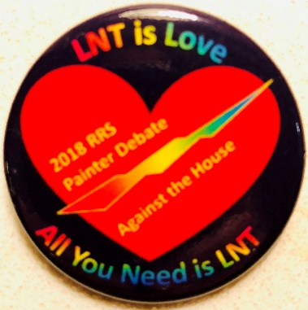
Validity of LNT hypothesis
“The linear non-threshold dose response hypothesis may be used as a simple, convenient method to calculate numbers in radiation protection planning but should not be mistaken as a stringent scientific conclusion directly derived from the present state of knowledge of the processes involved in radiation carcinogenesis”.
Trott, K.R. and M. Rosemann, Molecular mechanisms of radiation carcinogenesis and the linear, non-threshold dose response model of radiation risk estimation. Radiat Environ Biophys, 2000, 39(2): p. 79-87.
Risk
LNT
Epidemiological risk data
Dose
Prof Francis Cucinotta
64th RRS, 2018
Notes:
Disagreement on low dose responses probably enrooted in the fact that researchers are working with different models, which might demonstrate not linearity. Therefore, there are many thresholds, value of which depends on experimental settings, this is smearing the picture.

Slide 12
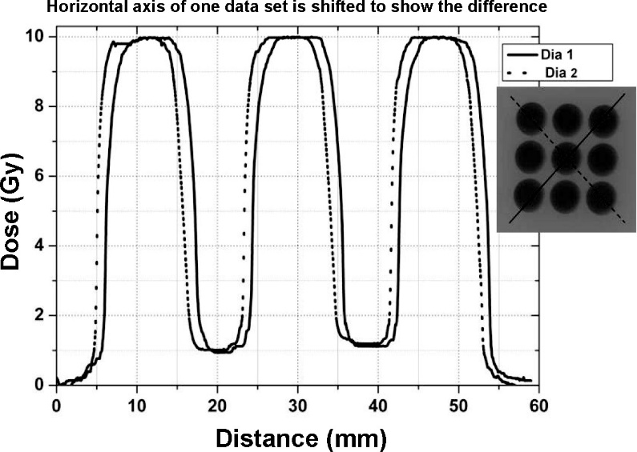
Spatially Fractionated Radiotherapy
Recently a revival of interest to Spatially Fractionated Radiotherapy (SFRT) is observed.
A number of SFRT experimental and clinical regiments are available: GRID, FLASH, IBT, Radiosurgery, SRS, LRT, and MRT.
GRID, IBT, Radiosurgery, and SRS are used in clinic; LRT, FLASH, MRT are in pre-clinical stage.
Better tumour control and lower damage to normal tissue.
20 (by invitation only) – 21 (open conference) August 2018, NIH-NCI, Bethesda, MD, USA
The common feature of SFRT regiments is non-uniform dose distribution
Rajalakshmi et al. RadRes, 2012
Notes:
GRID – Spatially fractionated radiation therapy (SFRT) using a GRID compensator allows treatment to be delivered through small openings
FLASH – radiation delivered in short pulses at ultrahigh dose rates
IBT - Intraoperative high-dose-rate brachytherapy
Radiosurgery - Gamma Knife and Cyberknife
SRS - Stereotactic Radiosurgery
LRT or LATTICE - Unconventional spatial-temporal beam configuration regiment
MRT - Microbeam Radiation Therapy

Slide 13
Spatially Fractionated Radiotherapy mechanisms
Bystander and abscopal effects
SFRT
mechanisms
of better tumor control and sparing of normal tissue
Vascular damage
and angiogenic response
Radiation induced immuno-response

Slide 14
Conclusions
The current system of radiation protection is conservative, and protects well humans and environment from harmful effects of ionising radiation.
Non-targeted effects of ionizing radiations seems to be embedded in the system and future mechanistic research are needed.
Radiation sensitivity and susceptibility in humans might contribute to radiation safety standards, but more mechanistic and methodological studies are needed.
Spatially Fractionated Radiotherapy regiments, which are arguably based on bystander and abscopal effects, are used in Radiation Oncology, although biological mechanisms are not well understood.

Slide 15
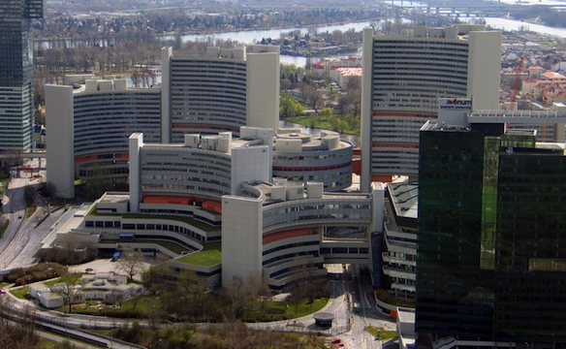
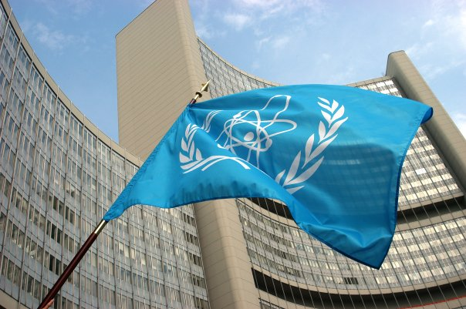
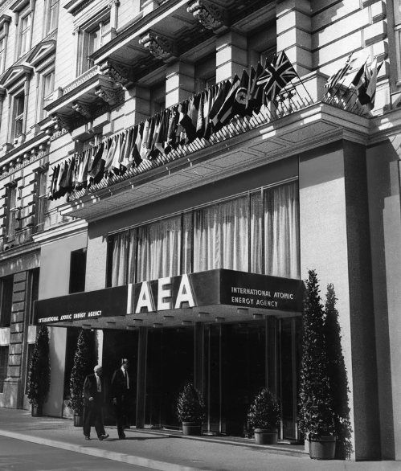
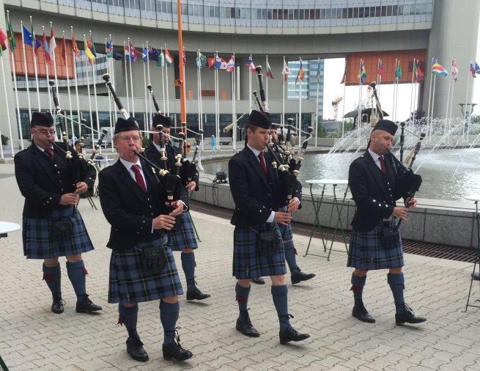
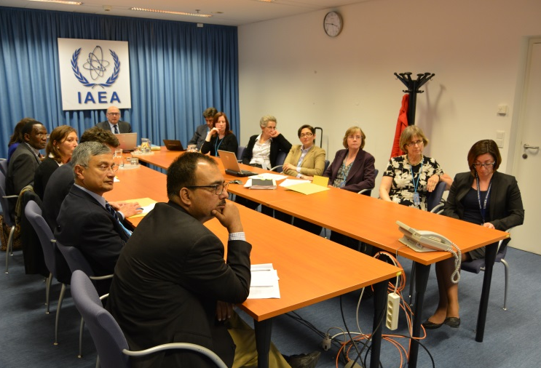
Thank you for your attention!
Notes:
Thank you!

